Slide 1
DiRLoc: Disentanglement Representation Learning for Robust Image Forgery Localization
Source: IEEE Transactions on Dependable and Secure Computing ( Early Access )
Authors: Ziqi Sheng, Zuomin Qu, Wei Lu, Xiaochun Cao, Jiwu Huang
Speaker: Yijie Lin
Date: 2025/01/23

Slide 2
Outline
Introduction
Proposed scheme
Experiments
Conclusions

Slide 3
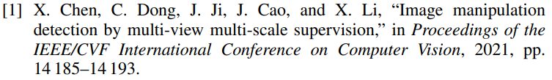
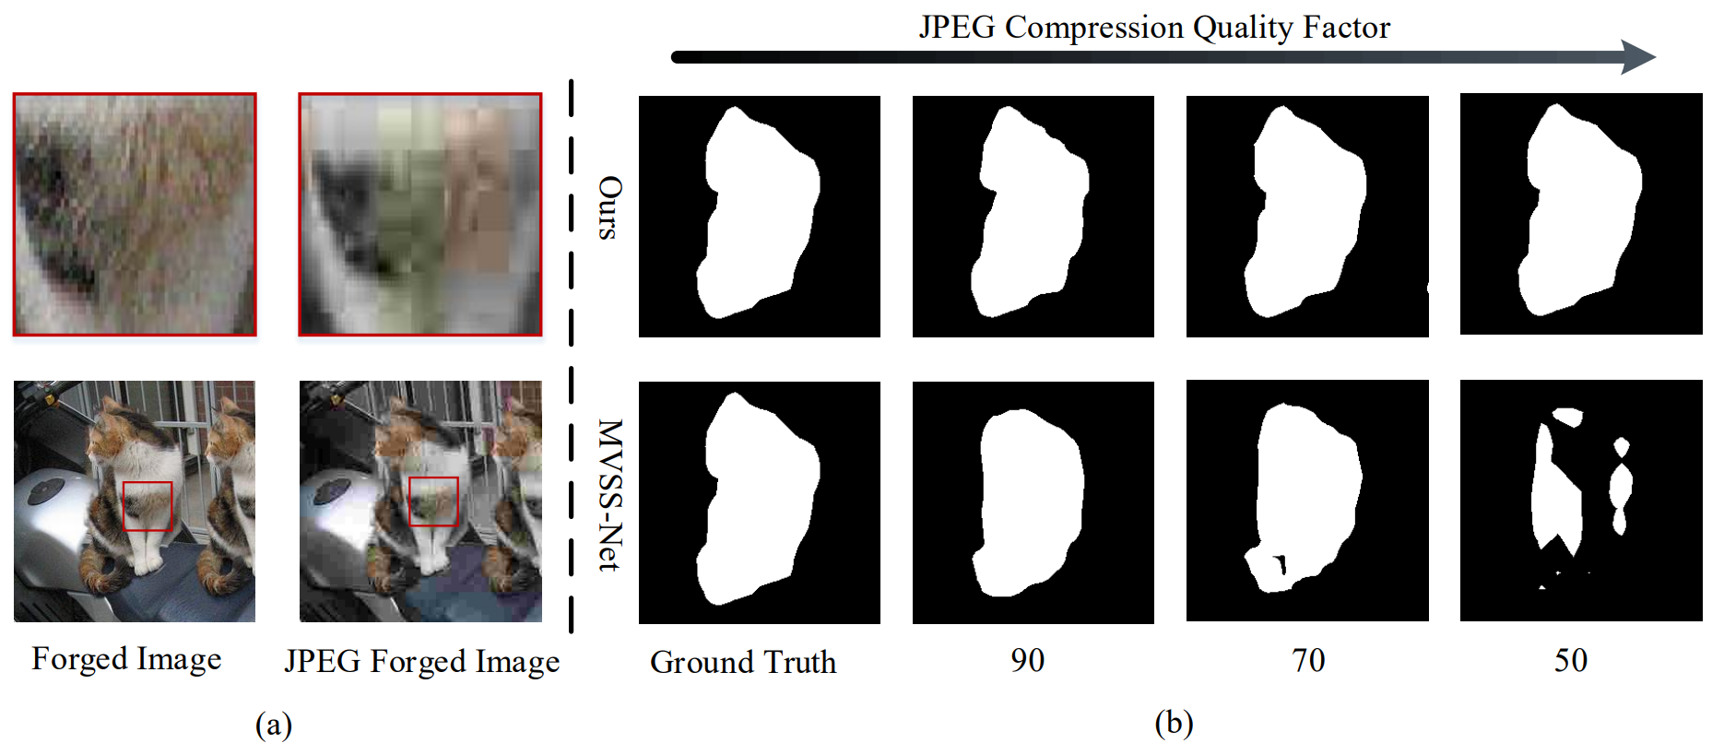
Introduction (1/2)

Slide 4
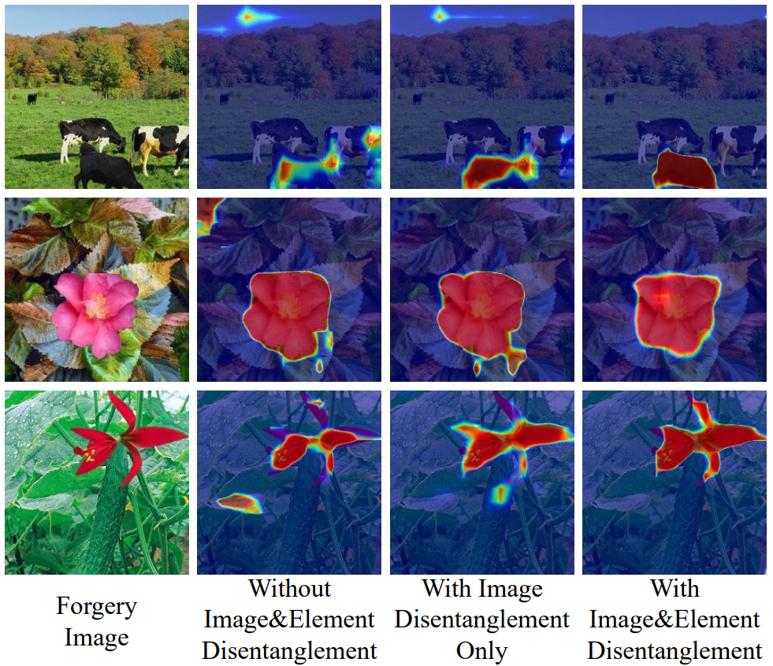
Introduction (2/2)

Slide 5
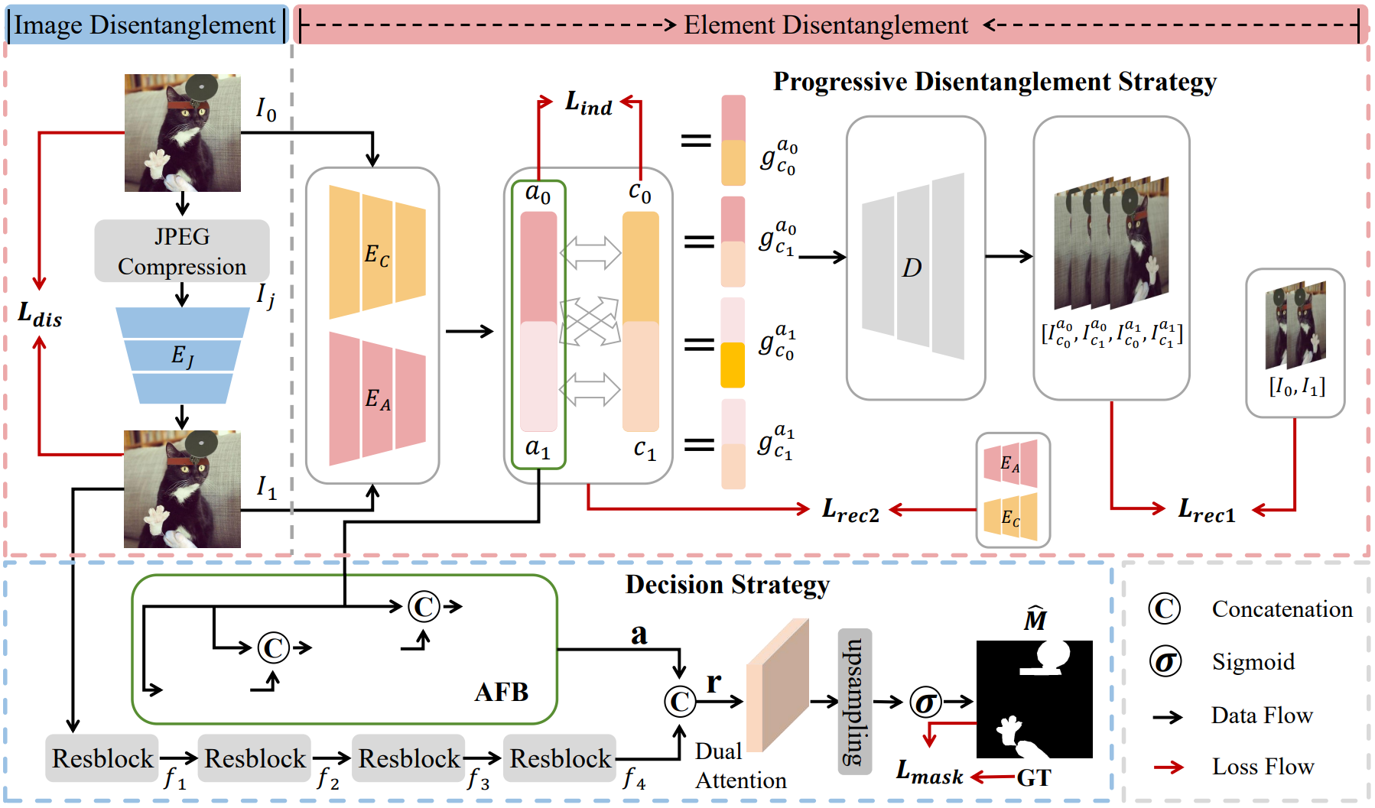
Proposed scheme (1/5)
DiRLoc: Disentanglement Representation learning for robust image forgery Localization

Slide 6
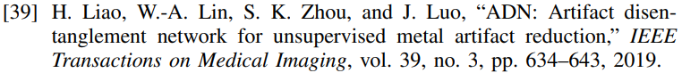
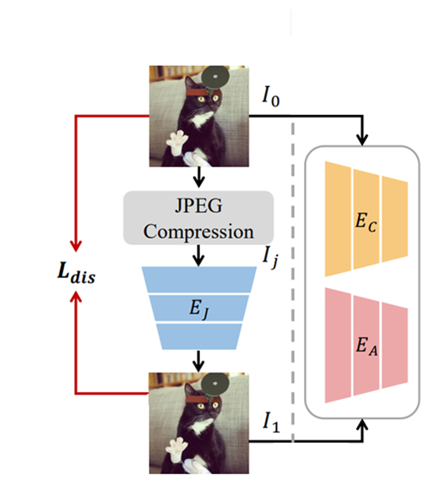
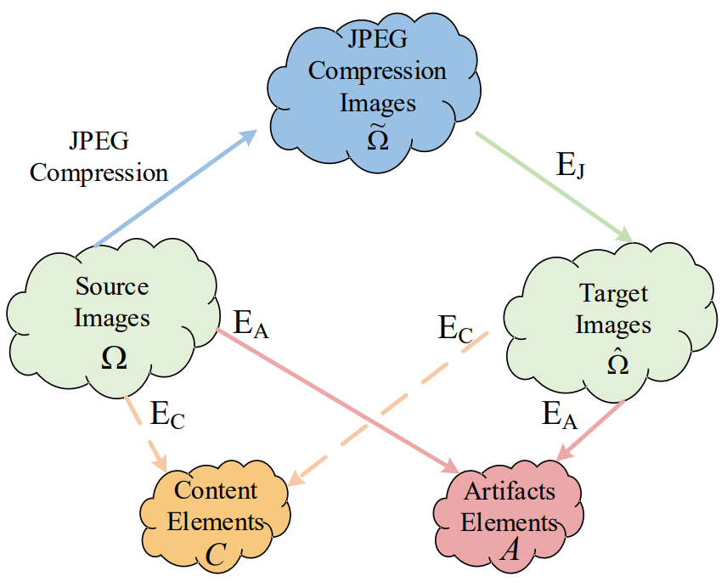
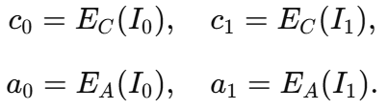

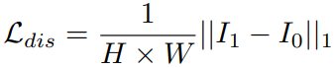
Proposed scheme (2/5)

Slide 7
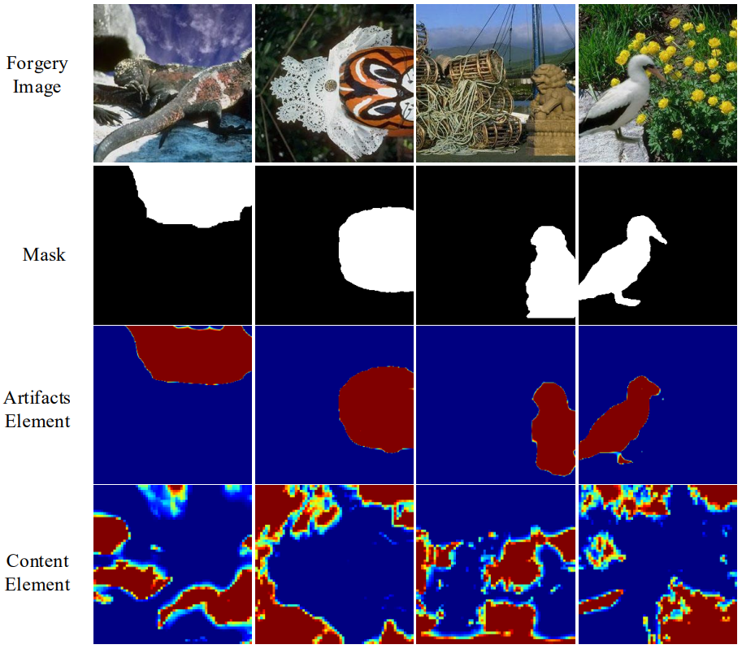
Proposed scheme (3/5)

Slide 8
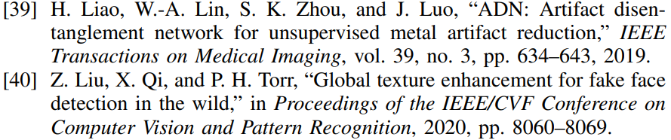
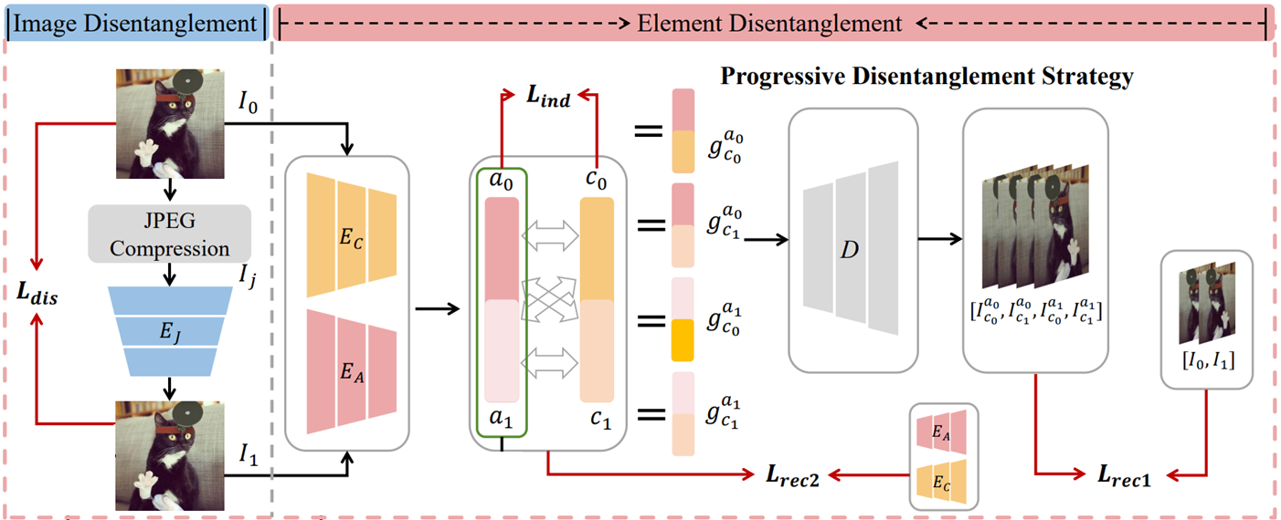
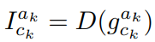

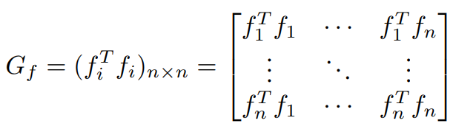
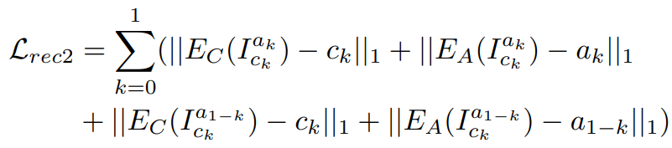
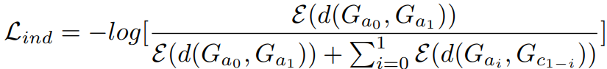
Proposed scheme (4/5)

Slide 9
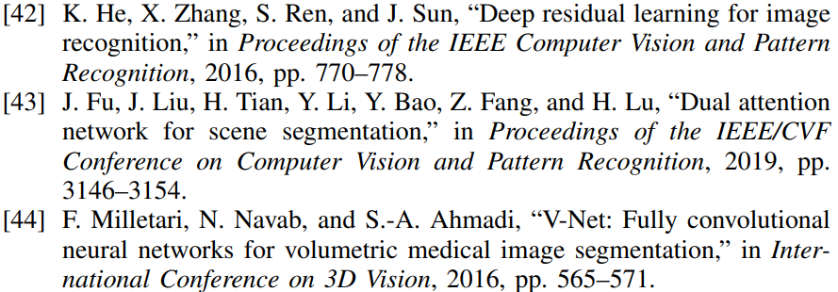
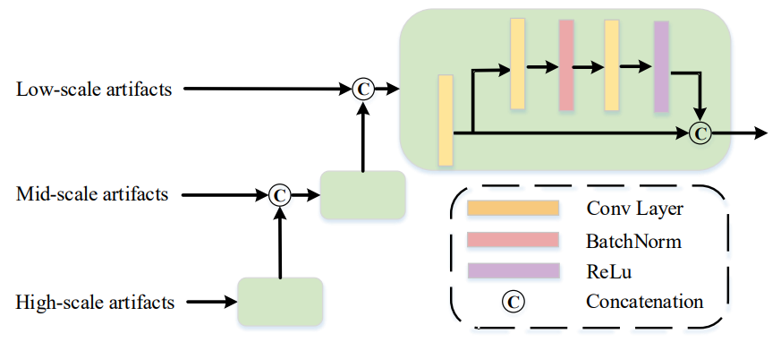
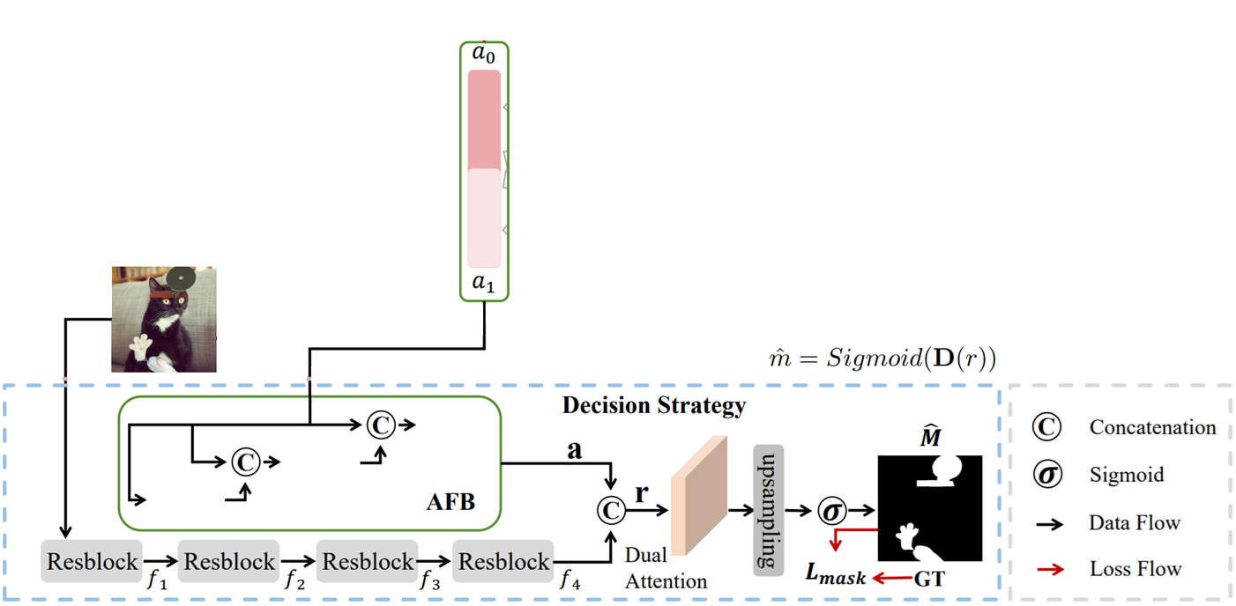
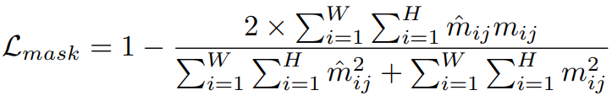
Proposed scheme (5/5)
AFB: Artifacts Fusion Block

Slide 10
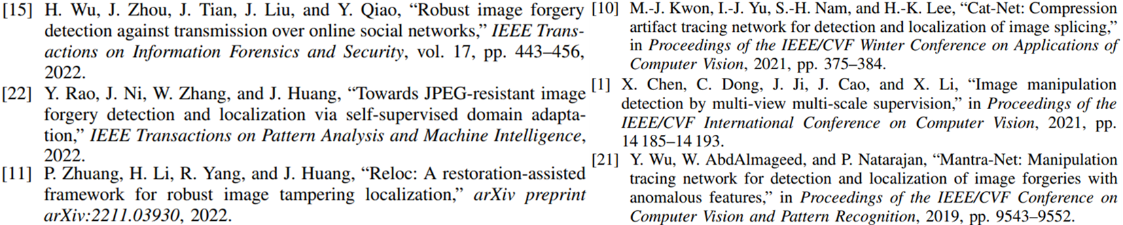
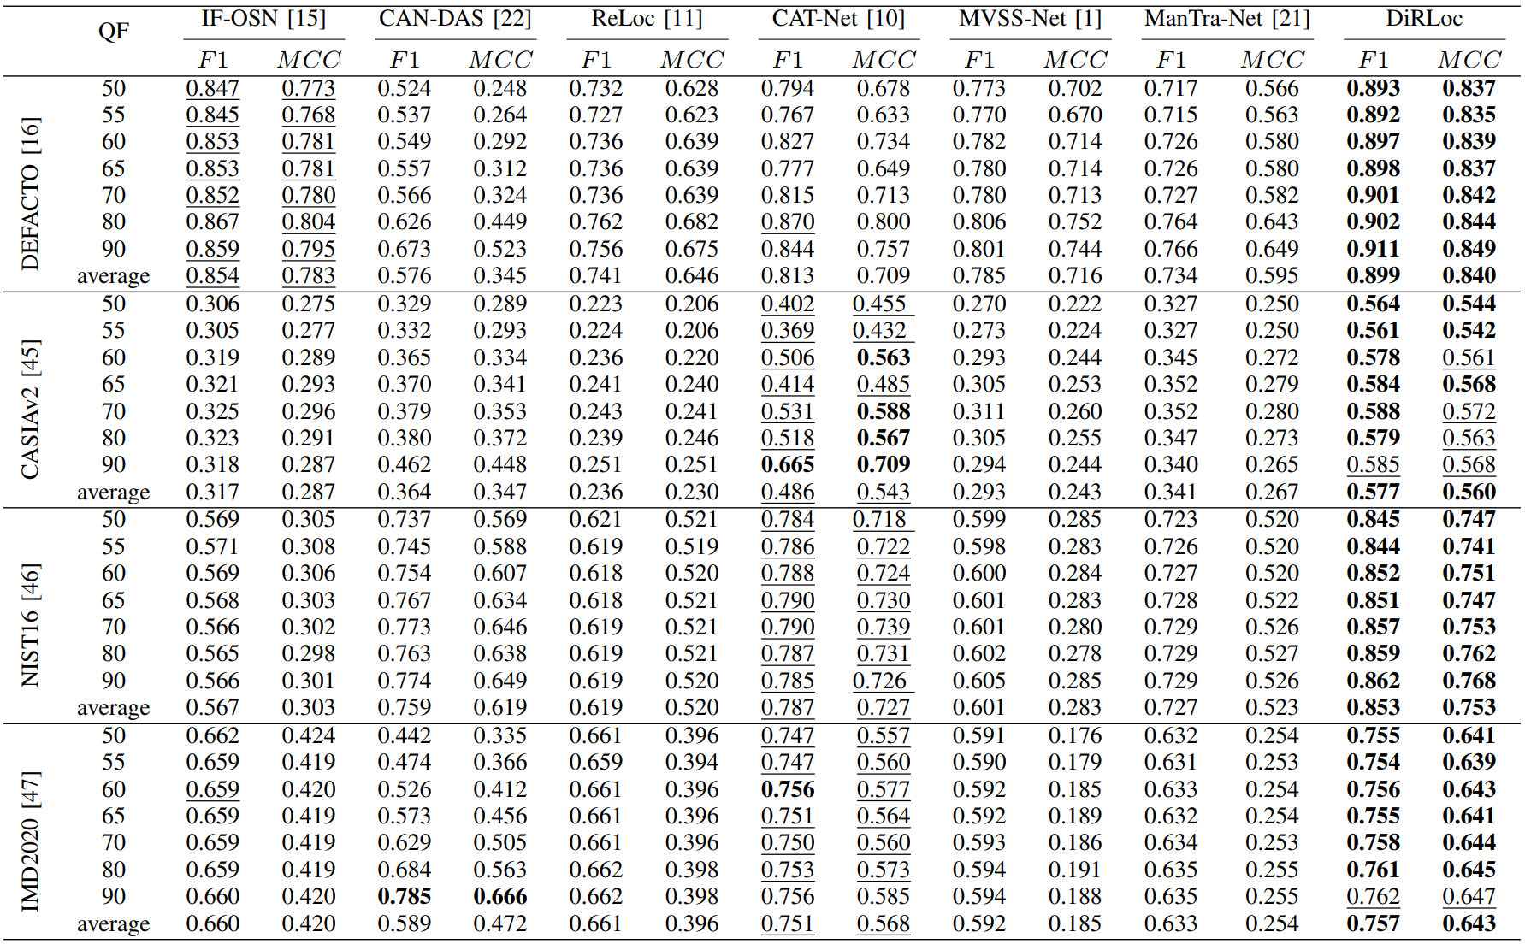
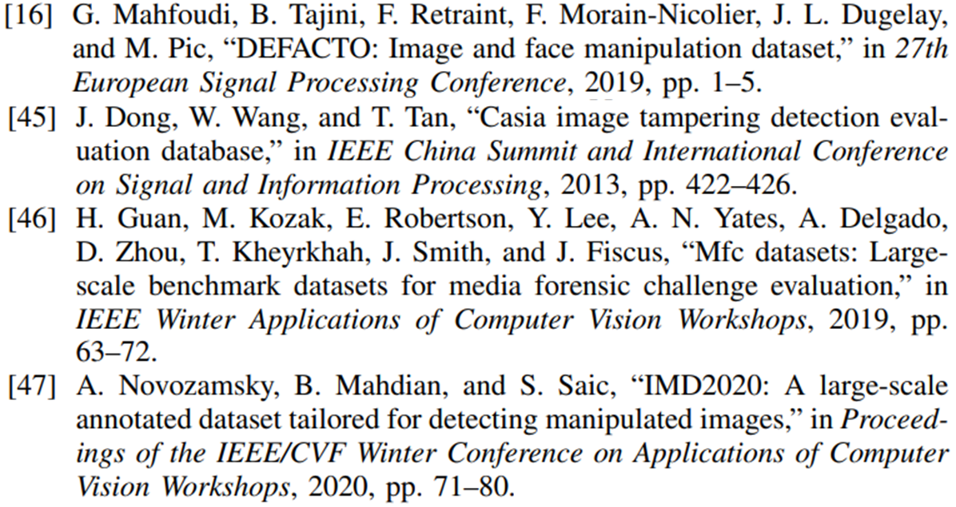
Experiments (1/5)

Slide 11
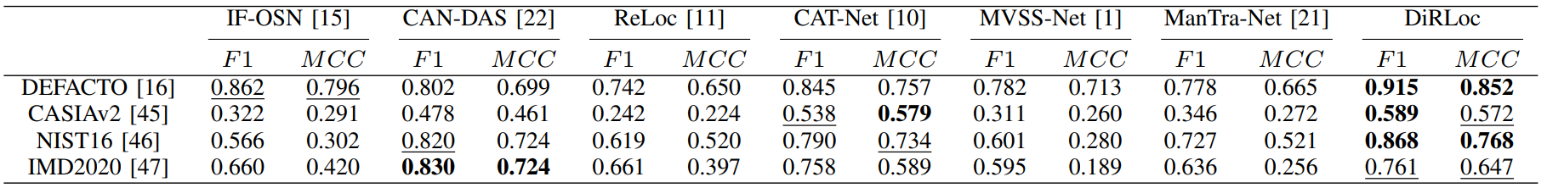
Experiments (2/5)

Slide 12
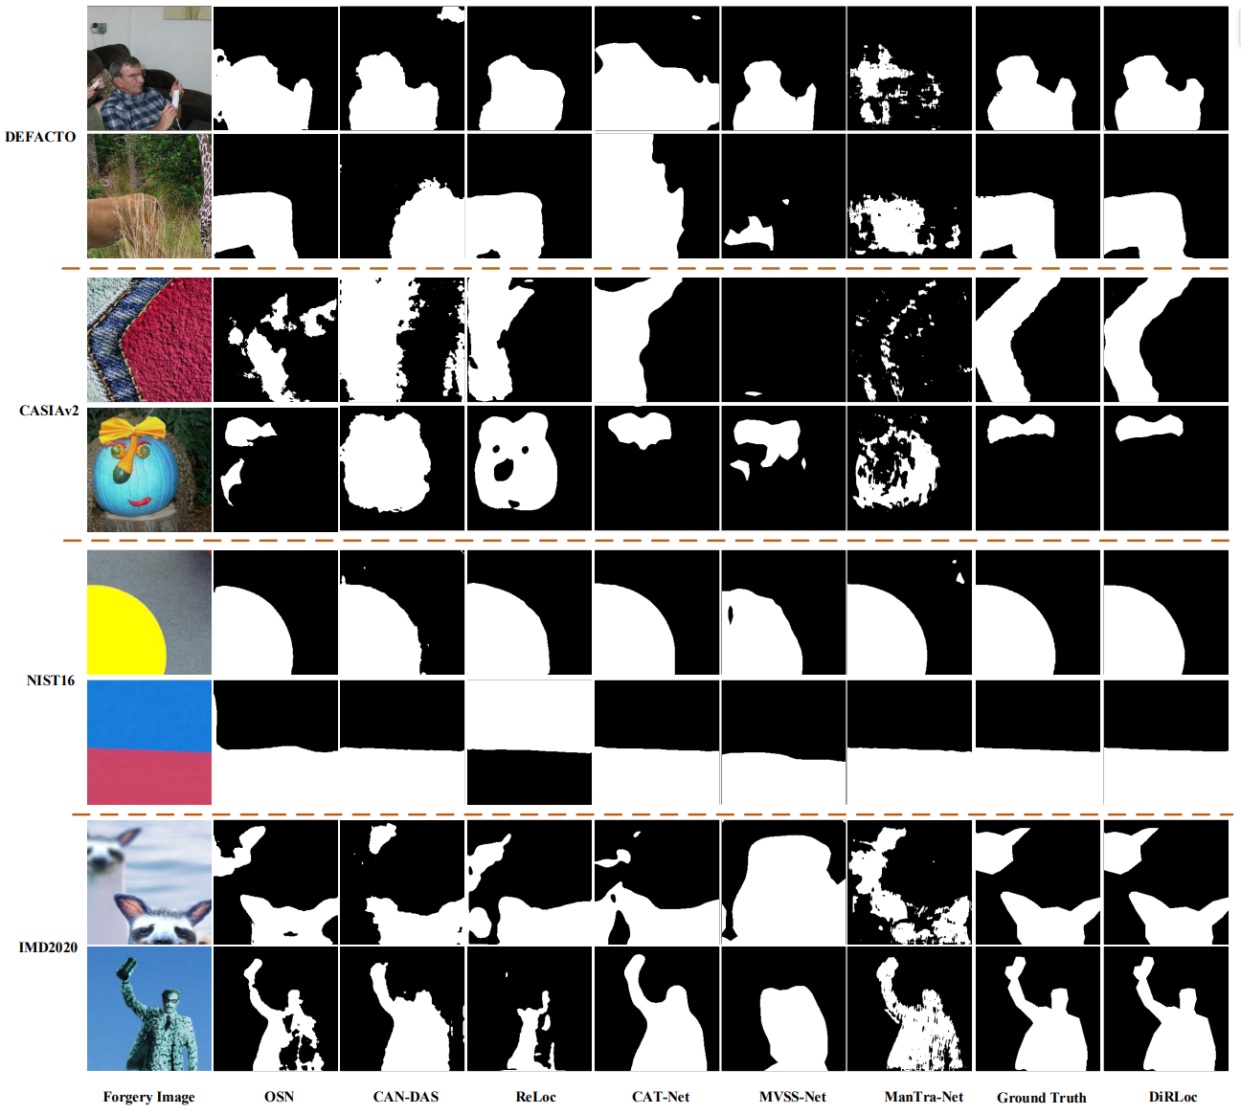
Experiments (3/5)

Slide 13
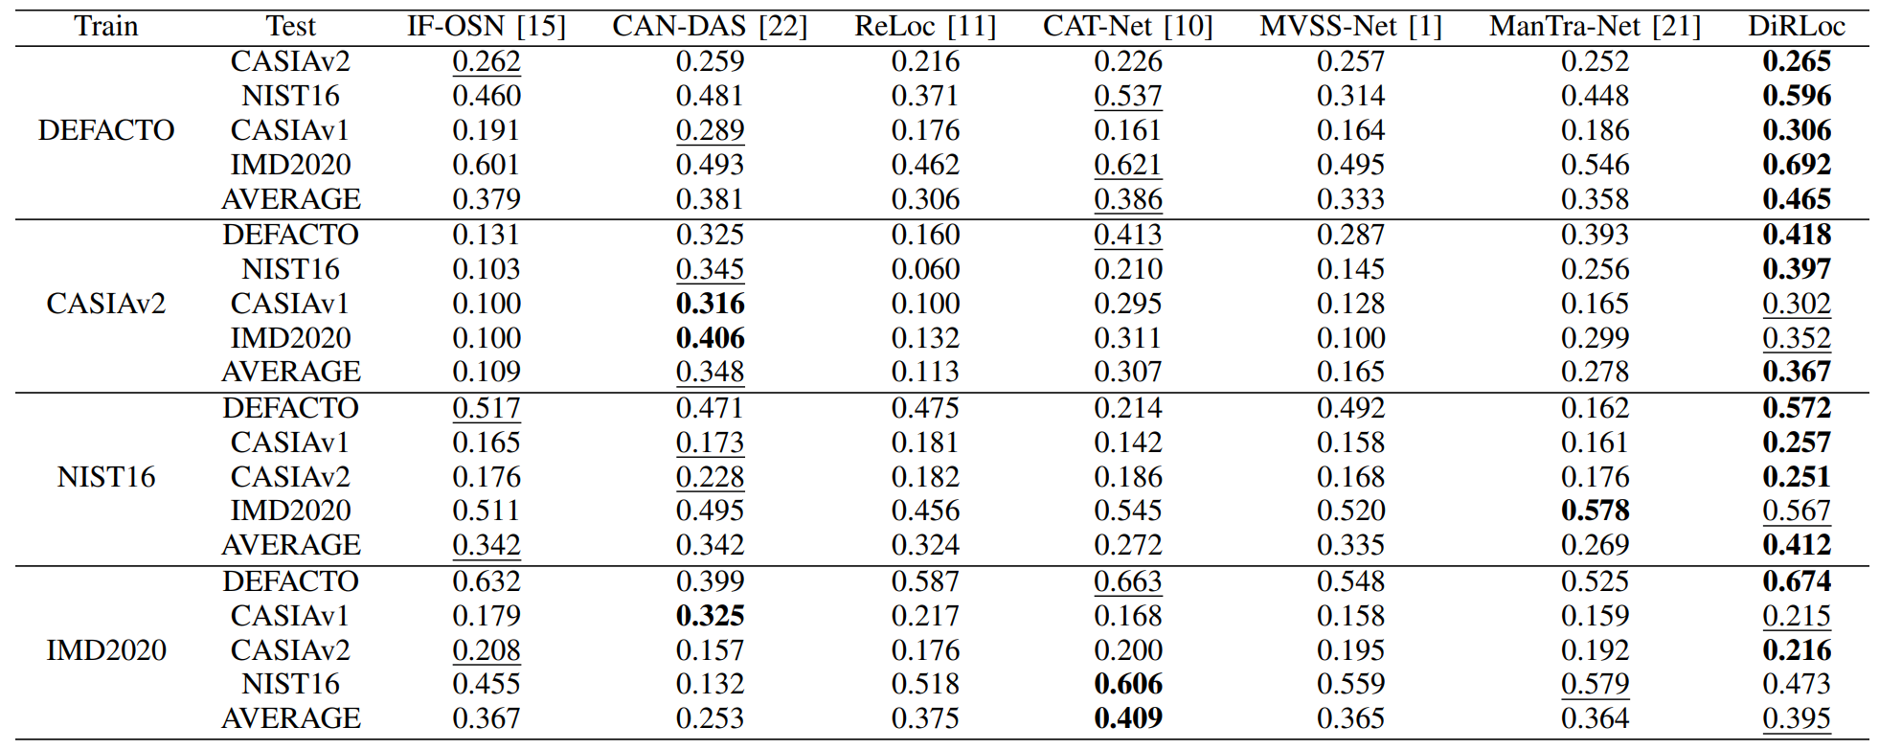
Experiments (4/5)

Slide 14
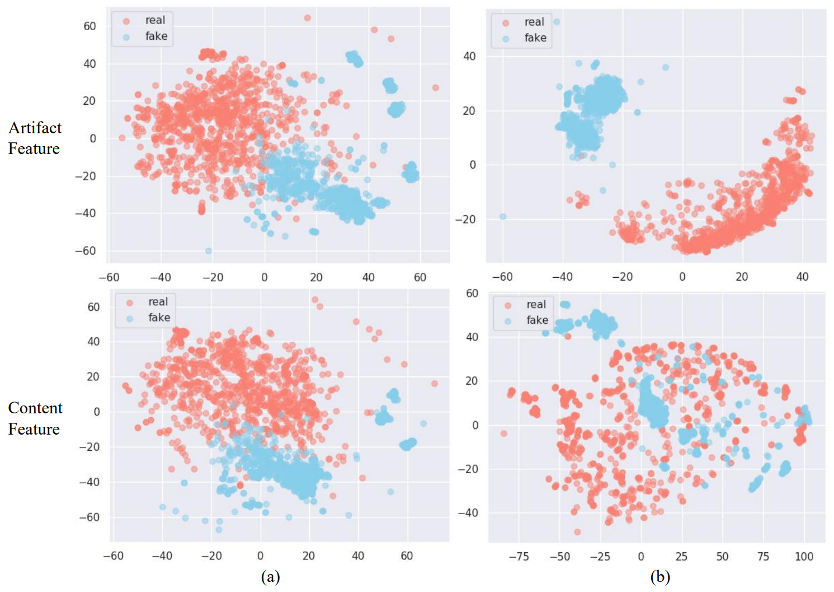
Experiments (5/5)

Slide 15
Conclusions
DiRLoc
Progressive Disentanglement Strategy
Artifacts Fusion Block
Generalization Performance

